Slide 1
UNIT IV
ELECTRONIC DEVICES AND CIRCUITS

Slide 2
CONTENTS
What are semiconductors
Importance of Semiconductors
Silicon and Germanium
P and N Type Materials
PN Junction Diodes
Forward and Reverse Biasing
Semiconductor diodes
BJT- Construction and Working
BJT Characteristics
FET-Working
Transistor Biasing
OP- Amp- Inverting and Non Inverting

Slide 3
What are semiconductors
The Semiconductors, such as Germanium, Silicon, Carbon, Selenium, etc. are the materials which are neither conductors nor insulators.
The conductivity of these materials lies in between or middle of the conductivity of conductors and insulators.
Semiconductors have some useful properties and are extensively used for the preparation of solid-state devices like the diode, transistor, etc.

Slide 4
What are semiconductors
Although the valence band of these substances is almost filled and the conduction band is almost empty as in case of insulators, but the forbidden energy gap between the valence band and the conduction band is very small (nearly 1 electron volt)
Therefore, an electric field, smaller than insulators and greater than conductors is required to push the valence electrons to the conduction band.
Few of the electrons cross the conduction band even at room temperature as some of the heat energy are imparted to the valence electrons.
As the temperature increases, more and more number of valence electrons cross over to the conduction band and the conductivity of the material increases. Thus, these materials have a negative temperature coefficient of resistance.

Slide 5
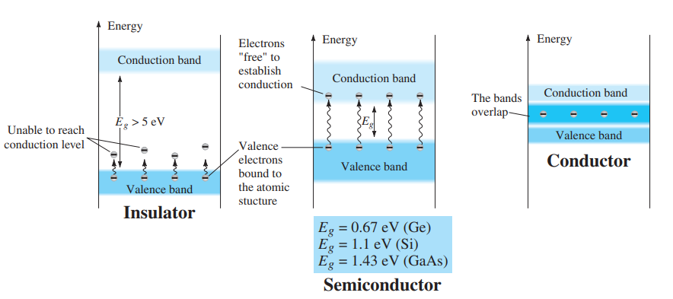
What are semiconductors
Substituting the charge of one electron and a potential difference of 1 V results in an energy level referred to as one electron volt .

Slide 6


Slide 7
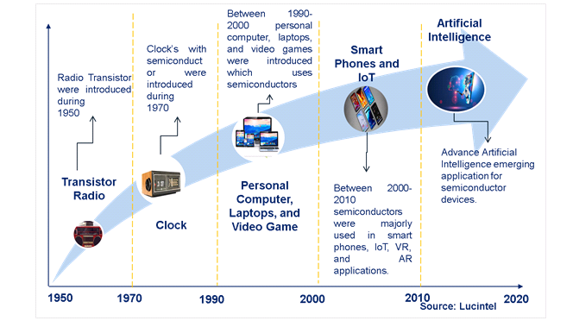
EVOLUTION OF SEMICONDUCTOR OPPORTUNITIES

Slide 8

Silicon and Germanium

Slide 9
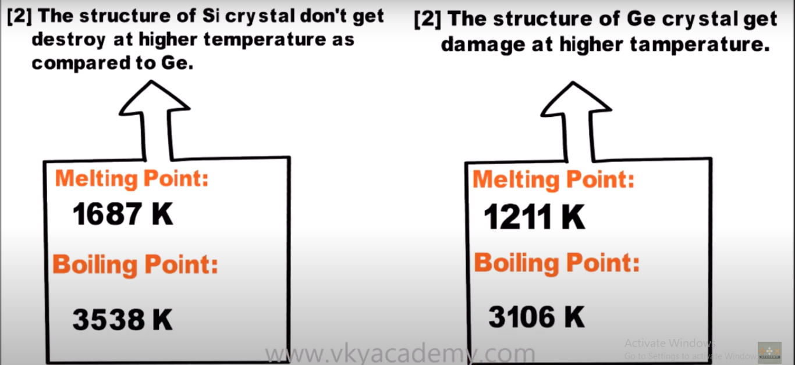
Silicon and Germanium

Slide 10
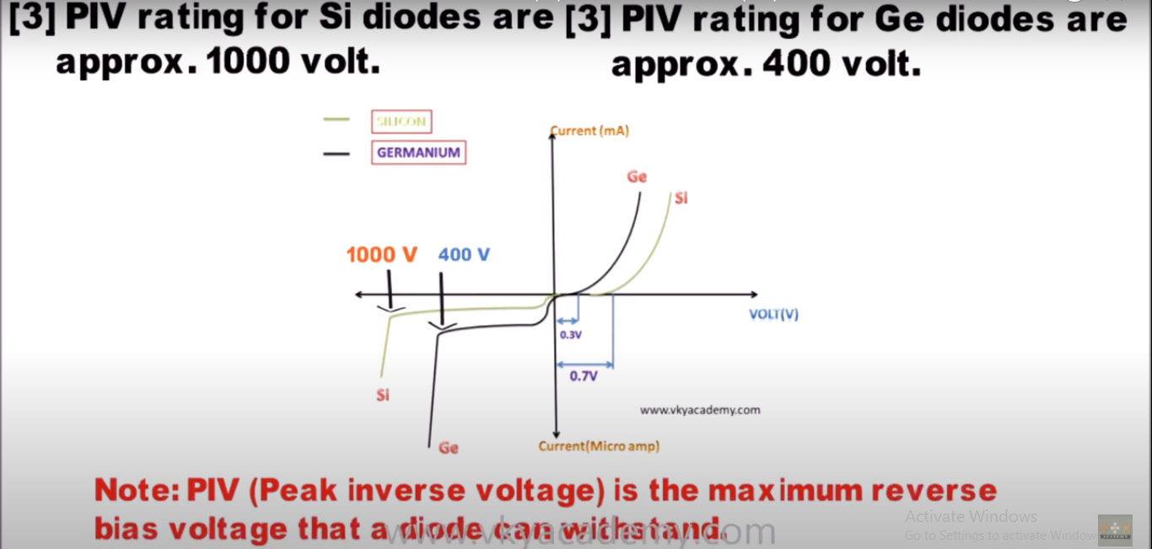
Silicon and Germanium

Slide 11
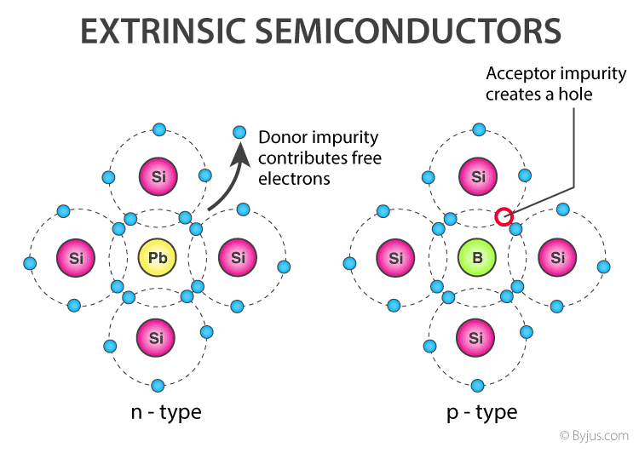
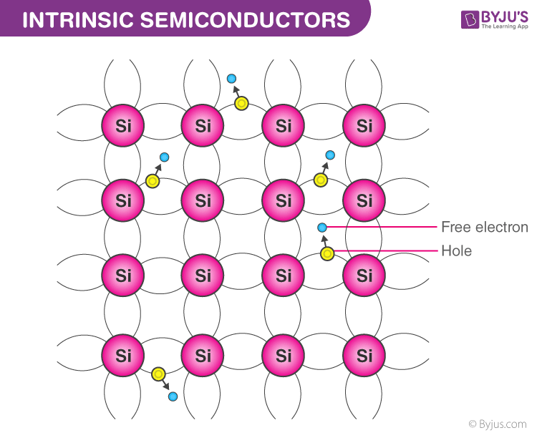
Types of semiconductors
INTRINSIC SEMICONDUCTORS
Intrinsic semiconductors are composed of only one kind of material; silicon and germanium are two examples. These are also called “un-doped semiconductors” or “i-type semiconductors”.
Extrinsic semiconductors, on the other hand, are intrinsic semiconductors with other substances added to alter their properties — that is to say, they have been doped with another element.

Slide 12
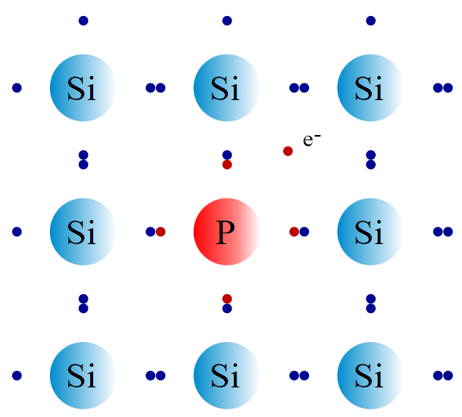
P AND N TYPE MATERIALS
N-type semiconductors are a type of extrinsic semiconductor in which the dopant atoms are capable of providing extra conduction electrons to the host material (e.g. phosphorus in silicon). This creates an excess of negative (n-type) electron charge carriers.

Slide 13
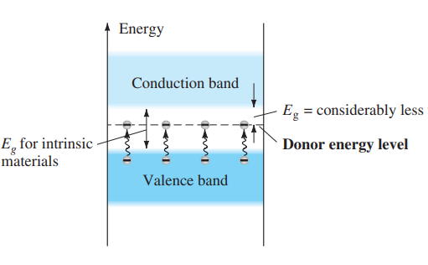
Effect of donor impurities on the energy band structure.

Slide 14
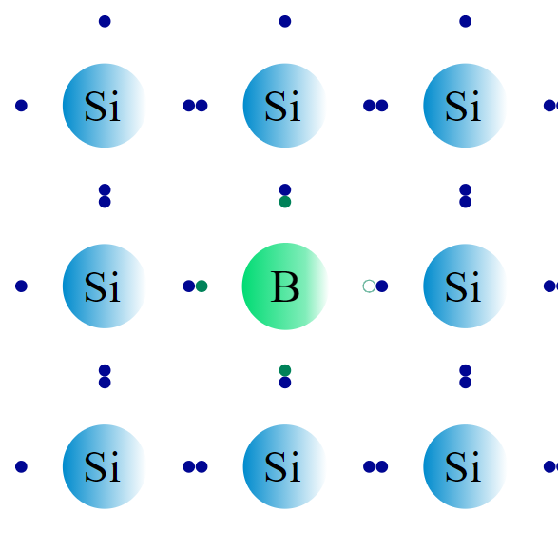
P AND N TYPE MATERIALS
A p-type (p for “positive”) semiconductor is created by adding a certain type of atom to the semiconductor in order to increase the number of free charge carriers.
When the doping material is added, it takes away (accepts) weakly bound outer electrons from the semiconductor atoms.
This type of doping agent is also known as an acceptor material, and the vacancy left behind by the electron is known as a hole.
The purpose of p-type doping is to create an abundance of holes.

Slide 15
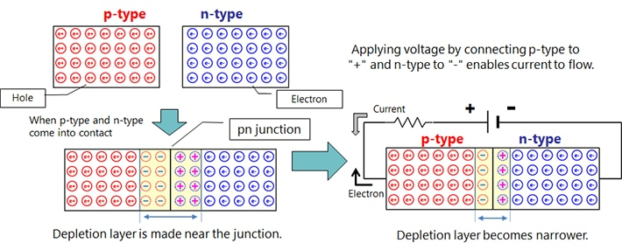
PN JUNCTION DIODE
A p-n junction is an interface or a boundary between two semiconductor material types, namely the p-type and the n-type, inside a semiconductor. The p-side or the positive side of the semiconductor has an excess of holes and the n-side or the negative side has an excess of electrons

Slide 16
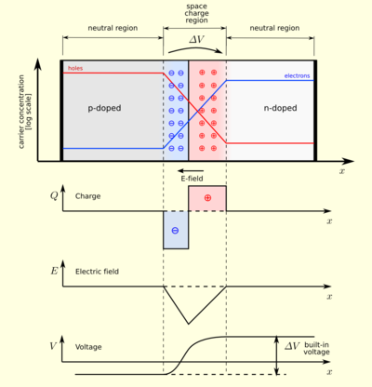
PN JUNCTION DIODE
When the p-type is connected to the negative terminal of the battery and the n-type is connected to the positive side then the p-n junction is said to be reverse biased.
In this case, the built-in electric field and the applied electric field are in the same direction.
When the two fields are added, the resultant electric field is in the same direction as the built-in electric field creating a more resistive, thicker depletion region.
The depletion region becomes more resistive and thicker if the applied voltage becomes larger.

Slide 17
How does current flow in PN junction diode?
The flow of electrons from the n-side towards the p-side of the junction takes place when there is an increase in the voltage.
Similarly, the flow of holes from the p-side towards the n-side of the junction takes place along with the increase in the voltage.
This results in the concentration gradient between both sides of the terminals.
Due to the formation of the concentration gradient, there will be a flow of charge carriers from higher concentration regions to lower concentration regions.
The movement of charge carriers inside the pn junction is the reason behind the current flow in the circuit.

Slide 18
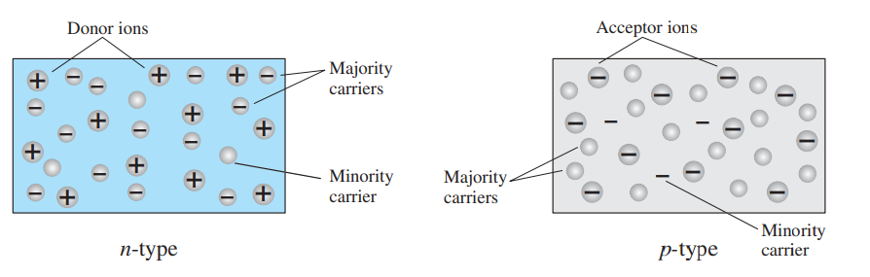
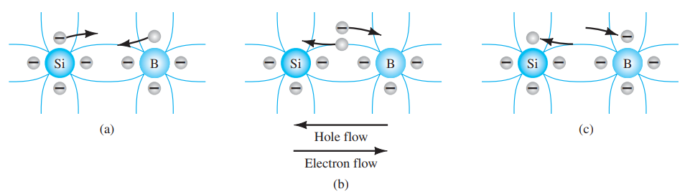

Slide 19
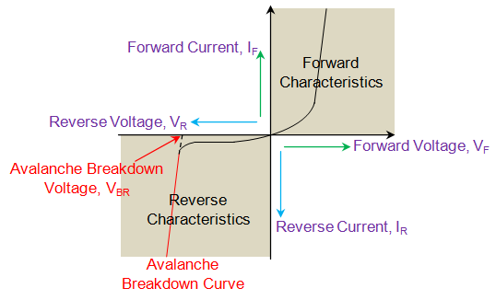
VI Characteristics of PN Junction Diode
VI characteristics of PN junction diodes is a curve between the voltage and current through the circuit.
Voltage is taken along the x-axis while the current is taken along the y-axis. The above graph is the VI characteristics curve of the PN junction diode.
With the help of the curve we can understand that there are three regions in which the diode works, and they are:
Zero bias
Forward bias
Reverse bias

Slide 20
Biasing
When the PN junction diode is under zero bias condition, there is no external voltage applied and this means that the potential barrier at the junction does not allow the flow of current.
When the PN junction diode is under forward bias condition, the p-type is connected to the positive terminal while the n-type is connected to the negative terminal of the external voltage.
When the diode is arranged in this manner, there is a reduction in the potential barrier. For silicone diodes, when the voltage is 0.7 V and for germanium diodes, when the voltage is 0.3 V, the potential barriers decrease and there is a flow of current.

Slide 21
Biasing
When the diode is in forward bias, the current increases slowly and the curve obtained is non-linear as the voltage applied to the diode is overcoming the potential barrier. Once the potential barrier is overcome by the diode, the diode behaves normally and the curve rises sharply as the external voltage increases and the curve obtained is linear.
When the PN junction diode is under negative bias condition, the p-type is connected to the negative terminal while the n-type is connected to the positive terminal of the external voltage. This results in an increase in the potential barrier. Reverse saturation current flows in the beginning as minority carriers are present in the junction.

Slide 22
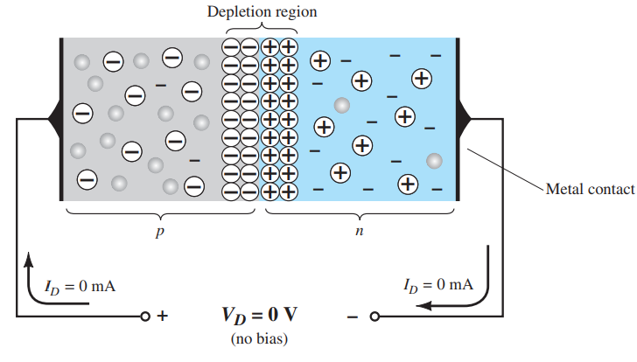
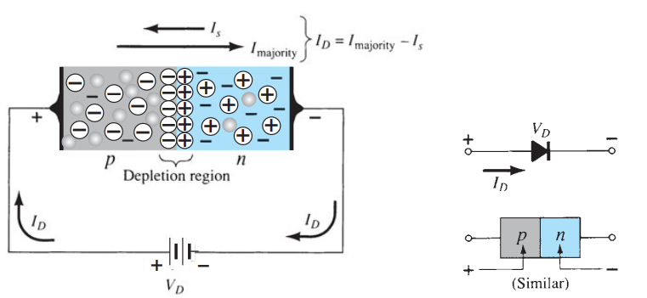
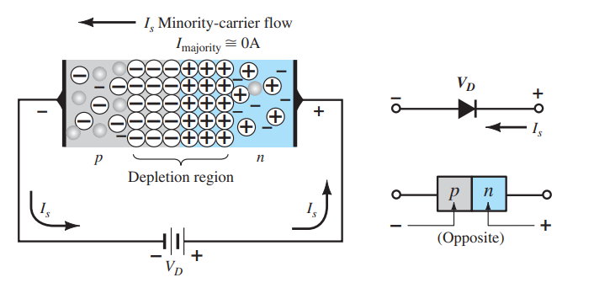
Zero Bias
Reverse Bias
Forward Bias

Slide 23
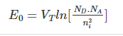
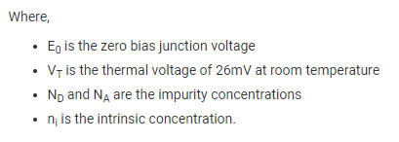
PN Junction formula

Slide 24
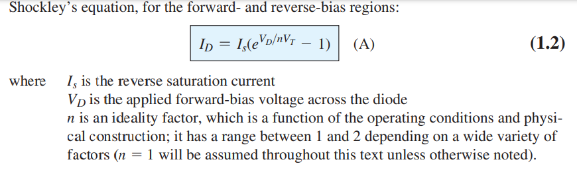
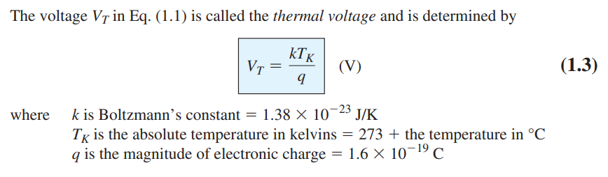

Slide 25
Avalanche Breakdown
I_{S} is observed to be almost independent of the applied voltage at its initial stage. However after reaching a particular point, the junction breaks-down leading to the heavy flow of reverse current through the device.
This is because, as the magnitude of the reverse voltage increases, the kinetic energy of the minority charge carriers also increase. These fast moving electrons collide with the other atoms in the device to knock-off some more electrons from them.
The electrons so released further release much more electrons from the atoms by breaking the covalent bonds. This process is termed as carrier multiplication and leads to a considerable increase in the flow of current through the p-n junction. The associated phenomenon is called Avalanche Breakdown
Avalanche breakdown occurs in lightly doped p-n junctions when the reverse voltage increases beyond 5 V. Further, it is difficult to control this phenomenon as the number of charge carriers generated cannot be directly controlled. Moreover the Avalanche breakdown voltage has positive temperature coefficient meaning which the Avalanche breakdown voltage increases with the increase in the junction temperature.

Slide 26
PIV Rating
The maximum reverse-bias potential that can be applied before entering the breakdown region is called the peak inverse voltage (referred to simply as the PIV rating) or the peak reverse voltage (denoted the PRV rating).

Slide 27


Slide 28
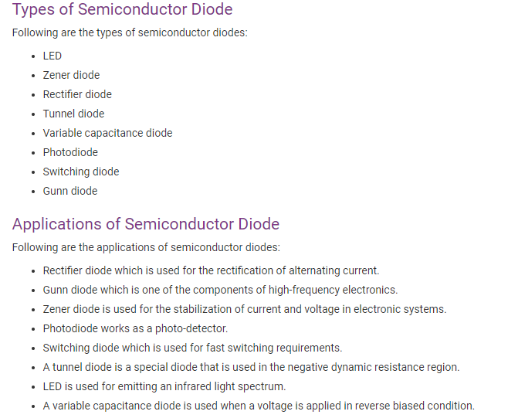

Slide 29
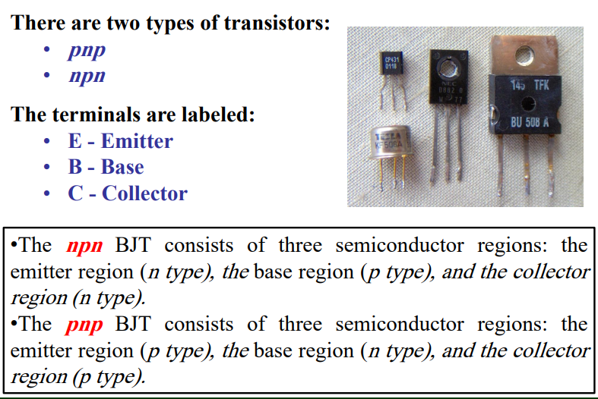
Bipolar Junction Transistor

Slide 30
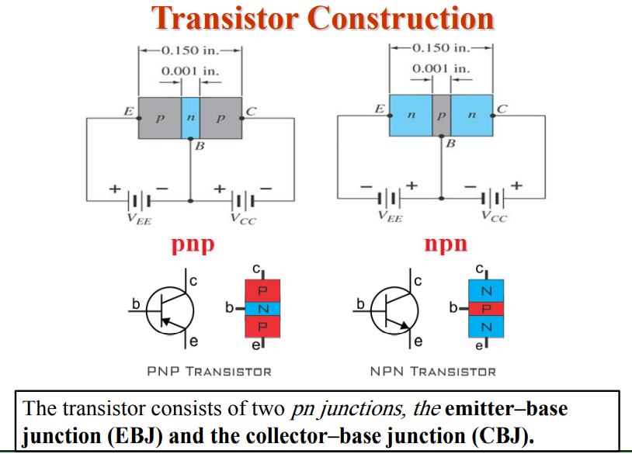
Construction of BJT

Slide 31
Emitter: The portion on one side of transistor that supplies charge carriers (i.e. electrons or holes) to the other two portions. ➢The emitter is a heavily doped region.
Emitter of PNP transistor supplies hole charges to its junction with the base. Similarly, the emitter of NPN transistor supplies free electrons to its junction with the base.
Collector is the portion on the other side of the transistor (i.e. the side opposite to the emitter) that collects the charge carriers (i.e. electrons or holes).
The doping level of the collector is in between the heavily doping of emitter and the light doping of the base.
Base: The middle portion which forms two PN junctions between the emitter and the collector is called the base. The base of transistor is thin, as compared to the emitter and is a lightly doped portion. The function of base is to control the flow of charge carrier.

Slide 32
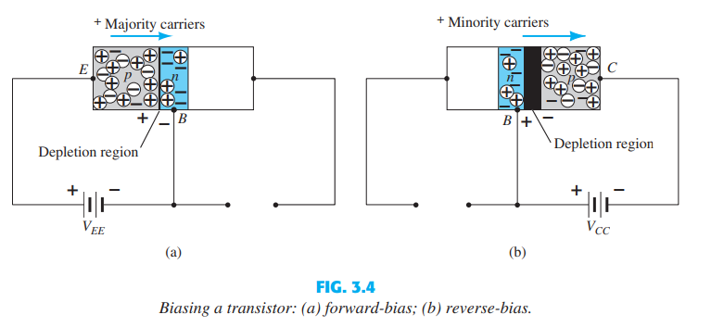
BJT Biasing

Slide 33
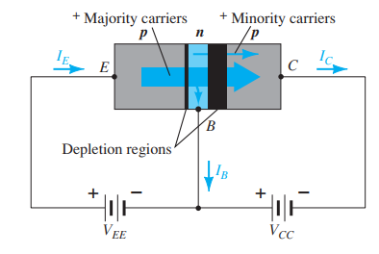
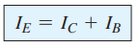
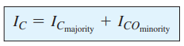
Majority and minority carrier flow of a pnp transistor.
With the external sources, VEE and VCC, connected as shown:
• The emitter-base junction is forward biased
• The base-collector junction is reverse biased
Applying Kirchhoff’s current law to the transistor

Slide 34
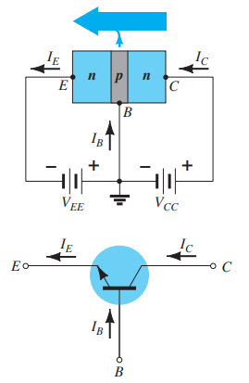
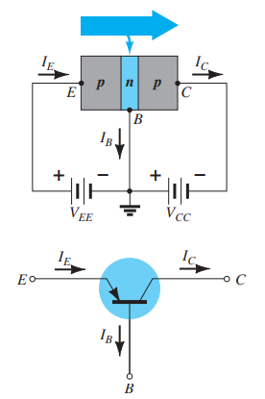
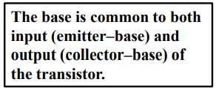
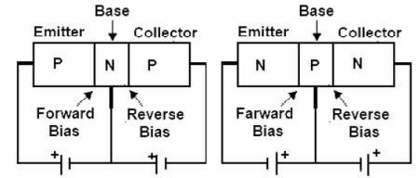
Common Base Configuration

Slide 35
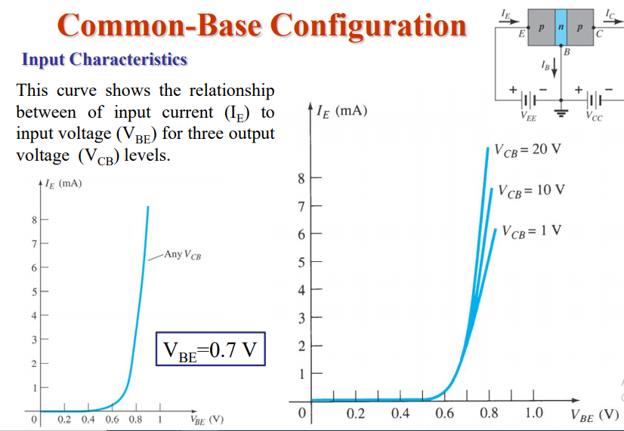

Slide 36
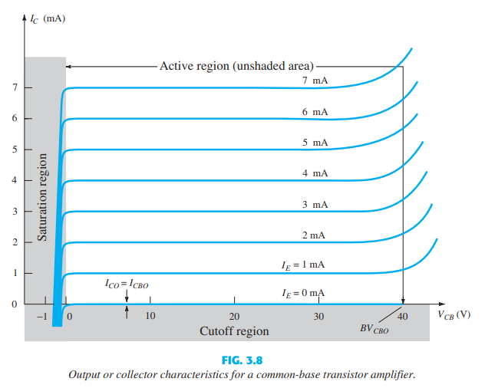
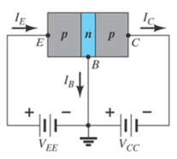
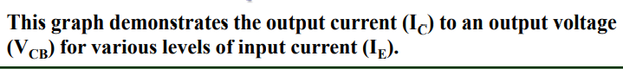
Output Characteristics

Slide 37
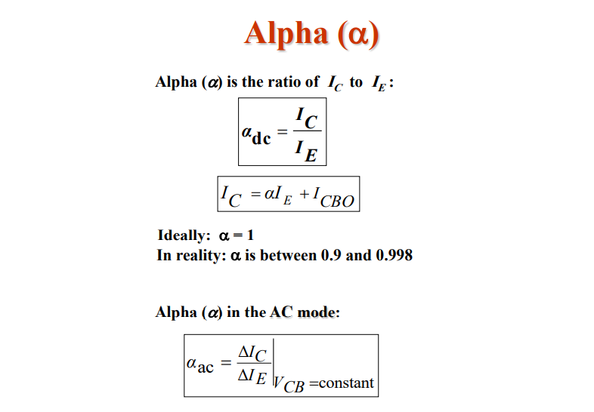
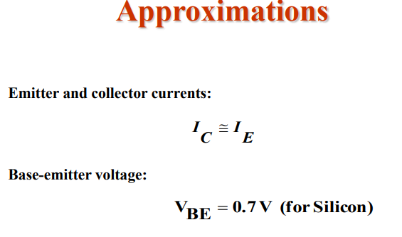

Slide 38
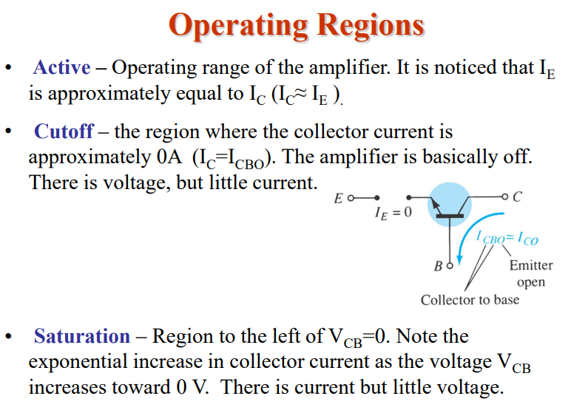

Slide 39
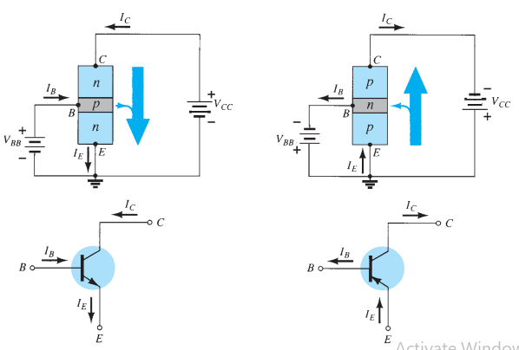
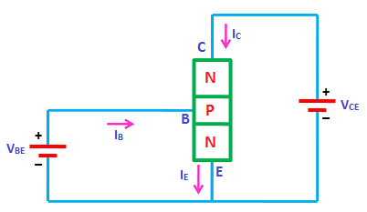
Common Emitter Configuration
The emitter is common to both the input and output terminals (in this case common to both the base and collector terminals).

Slide 40
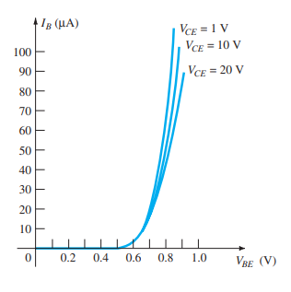
Input Characteristics
The input characteristics are a plot of the input current ( I B ) versus the input voltage ( V BE ) for a range of values of output voltage ( V CE ).

Slide 41
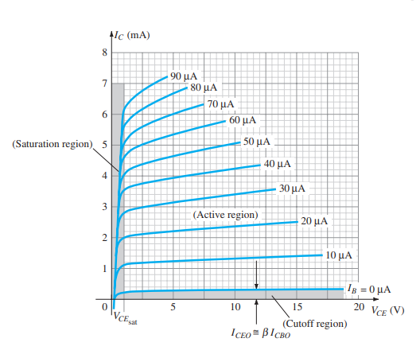
Output Characteristics
For the common-emitter configuration the output characteristics are a plot of the output current ( I C ) versus output voltage ( V CE ) for a range of values of input current ( I B ).
In the active region of a common-emitter amplifier, the base–emitter junction is forward-biased, whereas the collector–base junction is reverse-biased.
The cutoff region for the common-emitter configuration is not as well defined as for the common-base configuration. Note on the collector characteristics of Fig. 3.14 that I C is not equal to zero when I B is zero. For the common-base configuration, when the input current I E was equal to zero, the collector current was equal only to the reverse saturation current I CO , so that the curve I E0

Slide 42
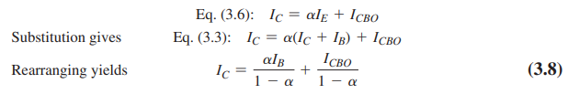
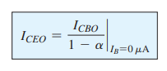

Slide 43
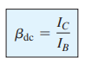
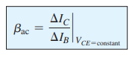
Beta (ᵦ)
In the dc mode the levels of I C and I B are related by a quantity called beta and defined by the following equation:
where I C and I B are determined at a particular operating point on the characteristics. For practical devices the level of b typically ranges from about 50 to over 400, with most in the midrange.
For ac situations an ac beta is defined as follows:
The formal name for bac is common-emitter , forward-current , amplification factor . Since the collector current is usually the output current for a common-emitter configuration and the base current is the input current, the term amplification is included

Slide 44
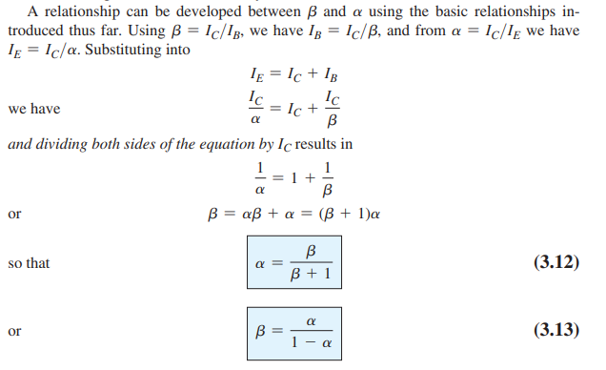
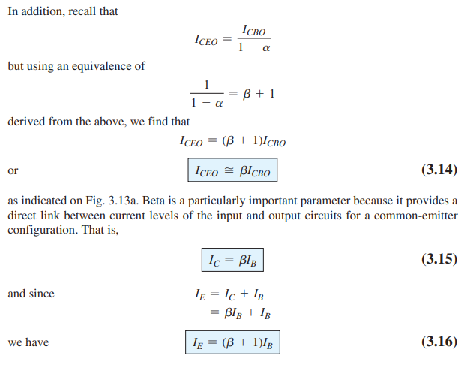
Relationship between Alpha and Beta

Slide 45
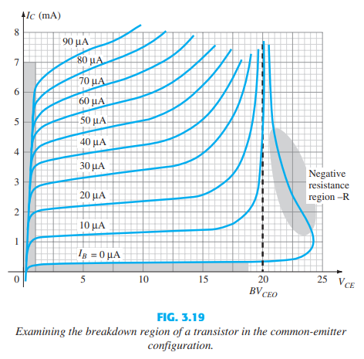
Breakdown Region CE Configuration
At high levels of base current the currents almost climb vertically, whereas at lower levels a region develops that seems to back up on itself.
This region is particularly noteworthy because an increase in current is resulting in a drop in voltage— totally different from that of any resistive element where an increase in current results in an increase in potential drop across the resistor.
This region is said to have Negative Resistance Characteristics.
For this breakdown region there are two reasons for the dramatic change in the curves. One is the avalanche breakdown mentioned for the common-base configuration, whereas the other, called punch-through, is due to the Early Effect .
In total the avalanche effect is dominant because any increase in base current due to the breakdown phenomena will be increase the resulting collector current by a factor beta.
This increase in collector current will then contribute to the ionization (generation of free carriers) process during breakdown, which will cause a further increase in base current and even higher levels of collector current.

Slide 46



Common Collector Configuration
The collector is tied to ground even though the transistor is connected in a manner similar to the common-emitter configuration
The common-collector configuration is used primarily for impedance-matching purposes since it has a high input impedance and low output impedance, opposite to that of the common-base and common emitter configurations.

Slide 47
Characteristics of CC configuration
The Output characteristics of the common-collector configuration are the same as for the common-emitter configuration. For the common-collector configuration the output characteristics are a plot of I E versus V CE for a range of values of IB .
For the input circuit of the common-collector configuration the common-emitter base characteristics are sufficient for obtaining the required information.

Slide 48



Limits of Operation
For each transistor there is a region of operation on the characteristics that will ensure that the maximum ratings are not being exceeded and the output signal exhibits minimum distortion

Slide 49

Field Effect Transistor
The field-effect transistor (FET) is a three-terminal device used for a variety of applications that match, to a large extent, those of the BJT transistor.
Although there are important differences between the two types of devices, there are also many similarities.
The primary difference between the two types of transistors is the fact that: The BJT transistor is a current-controlled device , whereas the JFET transistor is a voltage-controlled device.

Slide 50
Notable features
One of the most important characteristics of the FET is its high input impedance hence typical ac voltage gains for BJT amplifiers are a great deal more than for FETs.
FETs are more temperature stable than BJTs, and FETs are usually smaller than BJTs, making them particularly useful in integrated-circuit (IC) chips.

Slide 51

FET Types
FET Types
Metal Oxide Semiconductor FET
Metal Semiconductor FET
Junction FET
N-channel
P-channel
FET Types
Enhancement Mode
Depletion Mode

Slide 52

Junction Field Effect Transistor
The major part of the structure is the n -type material, which forms the channel between the embedded layers of p -type material.
The top of the n -type channel is connected through an ohmic contact to a terminal referred to as the drain (D) , whereas the lower end of the same material is connected through an ohmic contact to a terminal referred to as the source (S).
The two p -type materials are connected together and to the gate (G) terminal. In essence, therefore, the drain and the source are connected to the ends of the n -type channel and the gate to the two layers of p -type material.
The result is a depletion region at each junction, as shown

Slide 53

Water analogy for the JFET control mechanism.
The source of water pressure can be likened to the applied voltage from drain to source, which establishes a flow of water (electrons) from the spigot (source). The “gate,” through an applied signal (potential), controls the flow of water (charge) to the “drain.” The drain and source terminals are at opposite ends of the n -channel because the terminology is defined for electron flow.

Slide 54

VGS=0 V, VDS Some Positive Value
A positive voltage V DS is applied across the channel and the gate is connected directly to the source to establish the condition V GS 0 V.
The result is a gate and a source terminal at the same potential and a depletion region in the low end of each p -material similar to the distribution of the no-bias conditions.
The instant the voltage VDD (=VDS) is applied, the electrons are drawn to the drain terminal, establishing the conventional current I D with the defined direction of Fig. 6.5 . The path of charge flow clearly reveals that the drain and source currents are equivalent (ID = IS).

Slide 55

Depletion region width
The current I D will establish the voltage levels through the channel as indicated
The result is that the upper region of the p -type material will be reverse-biased by about 1.5 V, with the lower region only reverse-biased by 0.5 V
the greater the applied reverse bias, the wider is the depletion region—hence the distribution of the depletion region is as shown

Slide 56

Id versus Vds
As the voltage V DS is increased from 0 V to a few volts, the current will increase as determined by Ohm’s law
The relative straightness of the plot reveals that for the region of low values of V DS , the resistance is essentially constant. As V DS increases and approaches a level referred to as Vp.
The depletion regions will widen, causing a noticeable reduction in the channel width.
The more horizontal the curve, the higher the resistance, suggesting that the resistance is approaching “infinite” ohms in the horizontal region.

Slide 57

Pinch Off voltage:(VGS = 0 V, VDS = VP ).
If V DS is increased to a level where it appears that the two depletion regions would “touch” and a condition referred to as pinch-off will result.
The level of V DS that establishes this condition is referred to as the pinch-off voltage and is denoted by Vp.
At Pinch off voltage — ID maintains a saturation level defined as IDSS while the channel gets almost pinched off.
In reality a very small channel still exists, with a current of very high density.

Slide 58

JFET as a Current Source
As V DS is increased beyond V P , the region of close encounter between the two depletion regions increases in length along the channel, but the level of I D remains essentially the same.
In essence, therefore, once VDS > VP the JFET has the characteristics of a current source.
The current is fixed at ID = IDSS, but the voltage V DS (for levels > VP ) is determined by the applied load.
I DSS is the maximum drain current for a JFET and is defined by the conditions VGS= 0 V and VDS >|VP|.

Slide 59

Application of Negative Gate voltage Vgs <0
A negative voltage of -1 V is applied between the gate and source terminals for a low level of VDS . The effect of the applied negative-bias VGS is to establish depletion regions similar to those obtained with VGS 0 V, but at lower levels of VDS .
Therefore, the result of applying a negative bias to the gate is to reach the saturation level at a lower level of VDS.
The pinch-off voltage continues to drop in a parabolic manner as VGS becomes more and more negative. Eventually, VGS when VGS = -VP will be sufficiently negative to establish a saturation level that is essentially 0 mA, and for all practical purposes the device has been “turned off.”
The level of V GS that results in ID= 0 mA is defined by VGS =VP, with VP being a negative voltage for n-channel devices and a positive voltage for p-channel JFETs.

Slide 60


JFET Characteristics
The region to the left of the pinch-off locus of Fig. 6.11 is referred to as the ohmic or voltage-controlled resistance region.
In this region the JFET can actually be employed as a variable resistor whose resistance is controlled by the applied gate-to-source voltage

Slide 61


p-channel JFET

Slide 62



Points to note
The maximum current is defined as I DSS and occurs when VGS = 0 V and VDS >= |VP| , as shown in Fig. 6.15a .
For gate-to-source voltages V GS is less than (more negative than) the pinch-off level, the drain current is 0 A ( ID =0A ), as in Fig. 6.15b .
For all levels of V GS between 0 V and the pinch-off level, the current ID will range between IDSS and 0A, respectively, as in Fig. 6.15c .
A similar list can be developed for p-channel JFETs.

Slide 63

Transfer Characteristics

Slide 64



Slide 65



Slide 66

Important Relations- JFET vs BJT

Slide 67

Transistor Biasing

Slide 68

Transistor Biasing

Slide 69


Slide 70


Slide 71


Slide 72


Slide 73


Slide 74


Slide 75


Slide 76


Slide 77


Slide 78


Slide 79


Slide 80


Slide 81


Slide 82


Slide 83


Slide 84


Slide 85


Slide 86


Slide 87
Operational Amplifiers
Operational Amplifiers, or Op-amps as they are more commonly called, are one of the basic building blocks of Analogue Electronic Circuits.
Operational amplifiers are linear devices that have all the properties required for nearly ideal DC amplification and are therefore used extensively in signal conditioning, filtering or to perform mathematical operations such as add, subtract, integration and differentiation.
An Operational Amplifier, or op-amp for short, is fundamentally a voltage amplifying device designed to be used with external feedback components such as resistors and capacitors between its output and input terminals

Slide 88
An Operational Amplifier is basically a three-terminal device which consists of two high impedance inputs. One of the inputs is called the Inverting Input, marked with a negative or “minus” sign, ( – ). The other input is called the Non-inverting Input, marked with a positive or “plus” sign ( + ).
A third terminal represents the operational amplifiers output port which can both sink and source either a voltage or a current.

Slide 89

Differential Amplifier
The circuit below shows a generalized form of a differential amplifier with two inputs marked V1 and V2. The two identical transistors TR1 and TR2 are both biased at the same operating point with their emitters connected together and returned to the common rail, -Vee by way of resistor Re.
The circuit operates from a dual supply +Vcc and -Vee which ensures a constant supply. The voltage that appears at the output, Vout of the amplifier is the difference between the two input signals as the two base inputs are in anti-phase with each other.

Slide 90
So as the forward bias of transistor, TR1 is increased, the forward bias of transistor TR2 is reduced and vice versa. Then if the two transistors are perfectly matched, the current flowing through the common emitter resistor, Re will remain constant.

Slide 91
Like the input signal, the output signal is also balanced and since the collector voltages either swing in opposite directions (anti-phase) or in the same direction (in-phase) the output voltage signal, taken from between the two collectors is, assuming a perfectly balanced circuit the zero difference between the two collector voltages.
This is known as the Common Mode of Operation with the common mode gain of the amplifier being the output gain when the input is zero.
Operational Amplifiers also have one output (although there are ones with an additional differential output) of low impedance that is referenced to a common ground terminal and it should ignore any common mode signals that is, if an identical signal is applied to both the inverting and non-inverting inputs there should no change to the output.

Slide 92
However, in real amplifiers there is always some variation and the ratio of the change to the output voltage with regards to the change in the common mode input voltage is called the Common Mode Rejection Ratio or CMRR for short.
Operational Amplifiers on their own have a very high open loop DC gain and by applying some form of Negative Feedback we can produce an operational amplifier circuit that has a very precise gain characteristic that is dependant only on the feedback used. Note that the term “open loop” means that there are no feedback components used around the amplifier so the feedback path or loop is open.
An operational amplifier only responds to the difference between the voltages on its two input terminals, known commonly as the “Differential Input Voltage” and not to their common potential. Then if the same voltage potential is applied to both terminals the resultant output will be zero. An Operational Amplifiers gain is commonly known as the Open Loop Differential Gain, and is given the symbol (A_{o}).

Slide 93


Slide 94


Slide 95


Slide 96

From these “idealized” characteristics above, we can see that the input resistance is infinite, so no current flows into either input terminal (the “current rule”) and that the differential input offset voltage is zero (the “voltage rule”). It is important to remember these two properties as they will help us understand the workings of the Operational Amplifier with regards to the analysis and design of op-amp circuits.

Slide 97

Pin Diagram of IC 741

Slide 98

Inverting Amplifier
This is because the junction of the input and feedback signal ( X ) is at the same potential as the positive ( + ) input which is at zero volts or ground then, the junction is a “Virtual Earth”. Because of this virtual earth node the input resistance of the amplifier is equal to the value of the input resistor, Rin and the closed loop gain of the inverting amplifier can be set by the ratio of the two external resistors.
In this Inverting Amplifier circuit the operational amplifier is connected with feedback to produce a closed loop operation. When dealing with operational amplifiers there are two very important rules to remember about inverting amplifiers, these are: “No current flows into the input terminal” and that “V1 always equals V2”. However, in real world op-amp circuits both of these rules are slightly broken.
There are two very important rules to remember about Inverting Amplifiers or any operational amplifier for that matter and these are.
No Current Flows into the Input Terminals
The Differential Input Voltage is Zero as V1 = V2 = 0 (Virtual Earth)

Slide 99



One final point to note about the Inverting Amplifier configuration for an operational amplifier, if the two resistors are of equal value, Rin = Rƒ then the gain of the amplifier will be -1 producing a complementary form of the input voltage at its output as Vout = -Vin. This type of inverting amplifier configuration is generally called a Unity Gain Inverter of simply an Inverting Buffer.

Slide 100

Non Inverting Amplifier
In this configuration, the input voltage signal, ( V_{IN} ) is applied directly to the non-inverting ( + ) input terminal which means that the output gain of the amplifier becomes “Positive” in value in contrast to the “Inverting Amplifier” circuit we saw in the last tutorial whose output gain is negative in value. The result of this is that the output signal is “in-phase” with the input signal.
Feedback control of the non-inverting operational amplifier is achieved by applying a small part of the output voltage signal back to the inverting ( – ) input terminal via a Rƒ – R2 voltage divider network, again producing negative feedback. This closed-loop configuration produces a non-inverting amplifier circuit with very good stability, a very high input impedance, Rin approaching infinity, as no current flows into the positive input terminal, (ideal conditions) and a low output impedance, Rout as shown below.

Slide 101



Gain

Slide 102

Voltage Follower
If we made the feedback resistor, Rƒ equal to zero, (Rƒ = 0), and resistor R2 equal to infinity, (R2 = ∞), then the resulting circuit would have a fixed gain of “1” (unity) as all the output voltage is fed back to the inverting input terminal (negative feedback). This configuration would produce a special type of the non-inverting amplifier circuit called a Voltage Follower, also known as a “unity gain buffer”.

